Slide 1
Generalizability
Discuss the possibility of generalizing the findings of this study. [9marks]

Slide 2
First, define...
To ‘generalize’ means
Results/findings are found relevant outside the study context
Chat task: We have to be very cautious about when arguing that generalization is appropriate especially when qualitative methods have been used.
Why? Come up with 2 solid reasons.

Slide 3
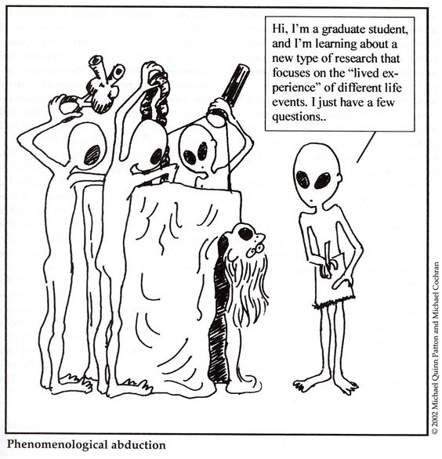
Types of Generalization

Slide 4
Type 1:
Representational generalization
Applying findings to populations (groups of people) outside the study’s population
Ex: A case study was built around trying to find out if nurses in surgical wards feel valued/respected by surgeons. Could findings be applied to another hospital’s surgical nursing staff? Which variables would need to be taken into account for this to be appropriate?

Slide 5
RG appropriate?
A boy was found by researchers – he had apparently been subsisting in a forest with animals. He moved comfortably on all fours and had limited language ability.
Is there any case in which some measure of RG might be appropriate? If so, to whom? If not, why not?

Slide 6
Type 2:
Inferential generalization
Applying findings to settings outside the study’s setting; also called ‘transferability’
Ex: A case study was run on finding out if surgical wards are efficient, safe places of work. Could findings be applied to another hospital’s surgical ward. Which factors would need consideration?

Slide 7
IG?
Semi structured interviews were conducted with staff from a elderly care home in order to get more info about facilities that support patient wellness. Researchers observed the facility, conducted interviews, took pictures, and used some of the facilities.
In what conditions might IG be possible with another care home?

Slide 8
Type 3:
Theoretical generalization
When a study’s findings expand/build on theoretical framework. When theoretical support comes from a study’s findings.
Ex: Researchers put forward to idea that exam stress in highschools increases when students are allowed to talk/socialize in the minutes before an exam. If a study shows this finding and supports theoretical concepts, one can argue theoretical generalizability.

Slide 9
Please remember:
Generalizability (the ability to transfer results to another population) is a term that is used most often w/quantitative research, due to similarities in SAMPLE
Be delicate/careful with discussing gen’y in qualitative research
It is often not the intention to generalize qualitative research, especially unique cases/rare populations/phenomena … let’s practice

