Slide 1
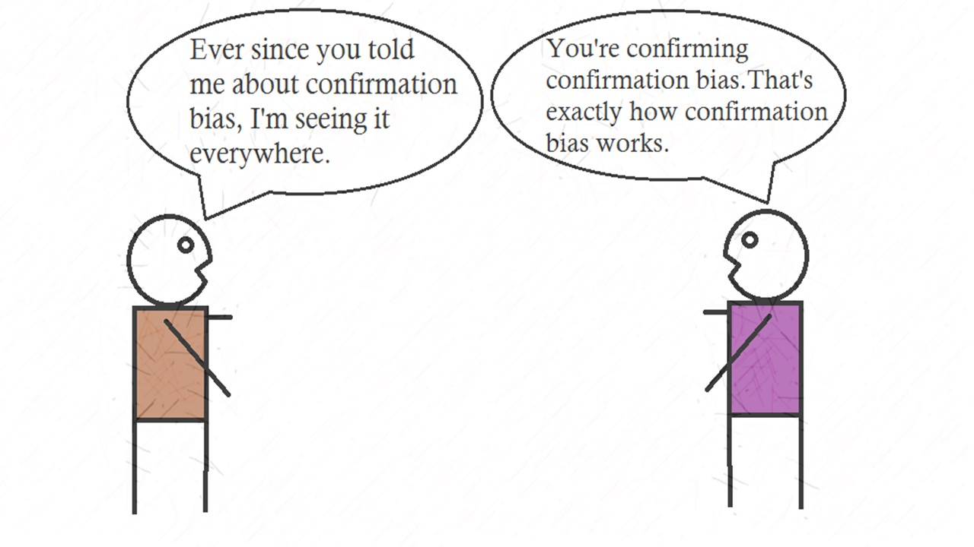
Bias
(p15-18 & p26-28)
Discuss how the researcher in the study could avoid bias. [9marks]

Slide 2
Bias
In research, an influenced interpretation or slanted view of design and/or findings/data.
Bias can come from sampling methods and/or how studies are designed.
Bias can also result from personal experience, opinions/judgments/emotions about the topic.

Slide 3
In Qualitative & Quantitative studies
To reduce bias generally, researchers can
Take care with how they construct questions/how they interact with participants so they aren’t influencing how participants feel or react
Be aware of sampling bias
Use triangulation to open procedures up to objective eyes
Be reflexive about their personal connection to the topic

Slide 4
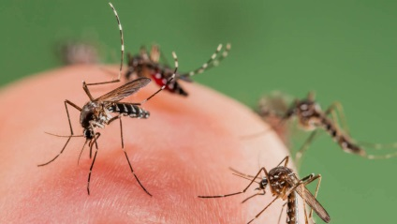
Controlling for bias in experiments
In an exp – ‘bias’ refers to confounding variables that may impact DV and compromise internal validity.
EX: If someone is trying to remember words and mosquitoes are trying to bite the person’s ear in a 1 minute memory trial, and the person remembers nothing b/c he was swatting mosquitos, the results are biased, or invalid.
IA confounding variables?

Slide 5
Controlling for bias (general)
Ensure participants have been selected/sampled properly considering the target group (if there is one).
EX: If you are running a memory experiment and you select ALL participants from a Memory Champion Tournament, results are BIASED, or skewed.

Slide 6
Controlling for bias in experiments
Controlling extraneous variables so they don’t get to the point of being confounding
EX: You run a memory exp, 2 trials. Control group run in room beside preschool classroom – practicing dino ‘ROARS’; Exp group: run in silence in a basement. Results would biased, invalid.
Single/double blind design – objective
Interpretation of results

Slide 7
Controlling for bias in experiments/longitudinal studies
Maturation: over course of long research, natural development in a participant (social, intellectual, emotional etc).
EX: You run a study at the beginning of part’s Gr 8 year (Aug) and again before they leave Gr 8 (June). You are interested in how they exhibit upstanderism online. What to do?

Slide 8
Controlling for bias (general)
Effects of testing/question-order bias:
activities an individual does in a study impact later performances or on other performance in study.
Ex: watching a video followed by a questionnaire on state of mind
Ex: Responding to one Q in a survey impacts response on next one
Counterbalance: have one group → video/quest, other group → quest/video
Reflect on Q order AND wording (triang in design)

Slide 9
Controlling for bias
Use of human researchers (ie: observation as part of experiment)
Ex: Observing aggressive play at breaks
Observer Tim is a morning person – alert/attentive at 10am. Not so much at 3pm when he’s sleepy and wants to nap.
What to do?

Slide 10
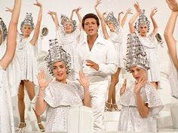
Controlling for bias in experiments
Part drop outs (mortality)
Not everyone continues with participation in research (exp or otherwise)
Why might people drop out?
What to do?

Slide 11
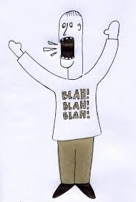
Controlling for bias (general)
Dominant participants in focus groups, group interviews, discussions
What’s the data issue?

Slide 12
Controlling for bias (general)
Social desirability: part’s behaving in way that they feel makes them look ‘good’, likeable, esp w/verbal/written responses.
Ex: in a qualitative study, part’s asked about treatment of colleagues.
What to do?

Slide 13
Practice
Rest of time today:
Pull out your last 2 assessed Paper 3s
Start a page of notes “Paper 3 Bias Practice”
Copy Q out: “Discuss how the researcher in the study could avoid bias.”
Brainstorm a list of possible relevant areas YOU would discuss, based on the stimulus

Slide 14
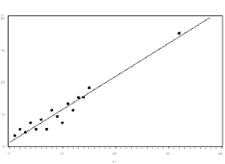
Controlling for bias in experiments
Mean regression
Extreme scores/outliers on tests tend to ‘even out’ – regress towards a statistical average or norm.

Slide 15
Controlling for bias in experiments
Mean regression
Ex: you are interested in phobias. You give a questionnaire to those phobic of open space. You pick the highest scores (most phobic). You run intervention, test again – scores will likely reduce, even out.
What to do? Control group w/similar initial rating but no intervention; comparison

