Slide 1
Welcome to IB Psychology

Slide 2
What are we studying in this course?

Slide 3
Where does this symbol come from?

Slide 4
How has psychology popped up on our radars this summer? Here are a few news bits from me – have a think of your own while listening/watching…

Slide 5
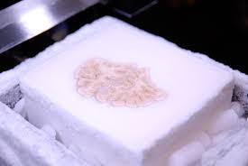
1st of 3 core units: Biological focus
Harvard’s brain bank

Slide 6
Core Principles
Patterns of behaviour can be inherited
Cognitions, emotions and behaviours are products of our nervous & endocrine systems
Animal research helps inform our understanding of human behaviour

Slide 7
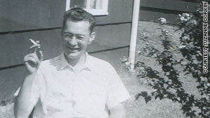
2nd of 3 core units: Cognitive Focus
Fight over HMs brain
Who’s HM? Why do people still care?
Brain slicing

Slide 8
Core Principles
We are information processors - mental representations guide behaviour
Mental processes – ‘the mind’ can be scientifically investigated
Cognitive processes are influenced by social and cultural factors

Slide 9
3rd of 3 core units: Socio-cultural Focus
Media focus on male v female athletes

Slide 10
This was a pretty big story – why?

Slide 11
Animals as healers
If you want to work at changing someone’s behaviour through therapy, how can you go about it?
Project Pooch

Slide 12
Core Principles
Social and cultural environments influence individual behaviour
As humans we are social animals and want connectedness/sense of belonging with others
We construct a social self, and an individual self

Slide 13
Abnormal Psychology (DP2)
The Anxiety of Bearing Witness – Paris attacks

Slide 14
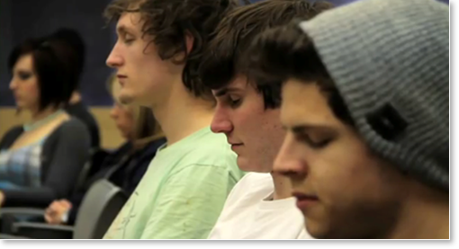
Health Psychology (DP2)
Using Meditation to Help Close the Achievement Gap

Slide 15
A few goals for the first few classes:
Get to know each other a bit!
Light course intro/Year Plan DP1
Syllabus – what is IB Psych; what are we studying?
Tips for course success
First 2 units (Research Methods, BLOA)
Assessment criteria; Command Terms/Critically focused Vocabulary

