Slide 1
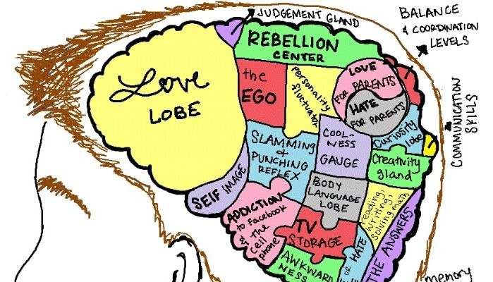
Brain & behaviour Localization in the brain

Slide 2
First, what is ‘localization’?
Theory: different brain areas/structures are responsible for certain behaviours/emotions/cognitions
Remember a core principle to the Biopsychological approach is that behaviours/emotions/cognitions are rooted in aspects of physiology, precise brain areas being one of them.
There’s interesting history of how psychologists went about exploring localization, so we’ll look at some older research to get started…

Slide 3
Buddy warm up:
Design 2 potential SAQ questions for this topic
Design 2 potential LAQ questions for this topic

Slide 4
SAQs – thoughts?

Slide 5
LAQs – thoughts?

Slide 6
SAQs LAQS
Describe localization with reference to research.
Explain one study related to localization.
Evaluate localization of brain function as an explanation of behaviour.
Discuss research methods used in the investigation of brain and behaviour (you could select localization).

Slide 7
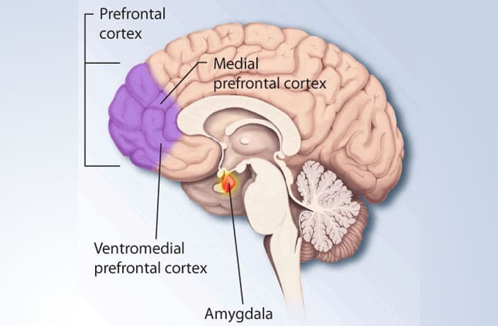
Why study ‘Localization’?
Crit A: Why might it matter to understand IF a certain behaviour/emotion/cognition is deeply implicated in a precise brain area? (Significance of investigation)
5 mins → What are some conditions/research methods that might allow for chance to study this?

Slide 8
Early conditions/methodology → localization: tech & pre tech
Autopsy → study post death; cut skull – look at the brain; observe (qualitative); look for irregularities (lesion/damaged area; tumor; dead areas)
+ explorative/visual – can compare w/‘normal’ dead brain
-- one point in time; non active – can’t see process; ‘dead’ – can’t see process or behavioural indicators– focus on result/outcome
Ethics: need consent (personal, or proxy ie: family provides consent)
What else?

Slide 9
Methodology → localization: tech & pre tech
Accidental damage → something happens - (lesion, injury, infection) – some process impacts the brain and creates a new scenario compared with a ‘normal’ brain
+ explorative/visual – can compare behavioural output w/‘normal’ live brain if sample somewhat close (age, lifestyle, gender); brain active and ‘working’
-- no control over damage – can’t replicate; very narrow generalizability; no 2 brain damages are the same!
Ethics: consent to study; respect to individual during research – trials, order effects of research (fatigue, boredom etc)

Slide 10
Methodology → localization: tech & pre tech
Intentional damage/surgery → something happens that researcher induces- (introduces lesion, injury, infection) – some process impacts the brain and creates a new scenario compared with a ‘normal’ brain
+ explorative/visual – can compare w/‘normal’ live brain if sample somewhat close (age, lifestyle, gender); brain active and ‘working’
+ researchers may have control over damage! Brain mapping potential
--Ethically compromised due to unknown outcome– last resort! When might this be considered?
Ethics: thorough consent/briefing/debriefing/monitoring, research overview

Slide 11
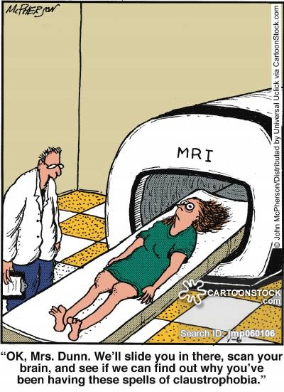
Methodology → localization: tech & pre tech
Scan the brain→ technology supports looking at brain images (MRI, structure) and brain activity (process), and others
We’ll get more into this with brain scanning techniques

Slide 12
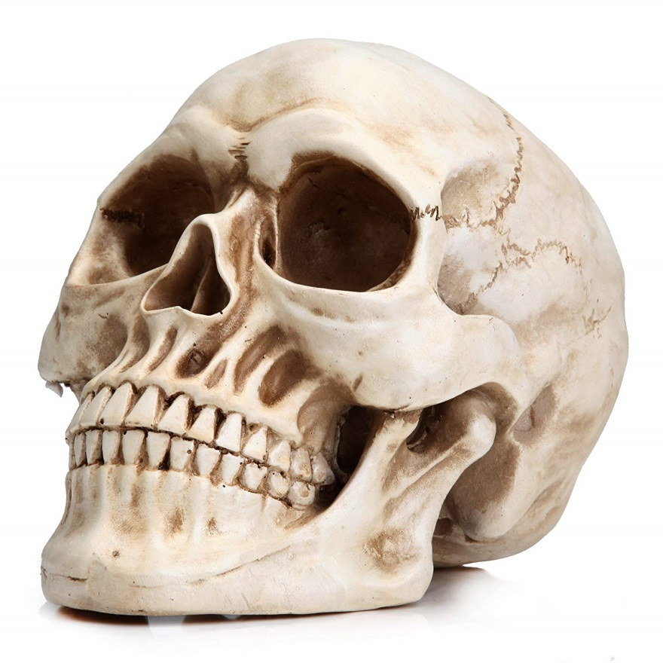
The start - Franz Joseph Gall (phrenology)
‘phrenology’ – study of cranium size/structure
Power of observation; hypothesizing

Slide 13
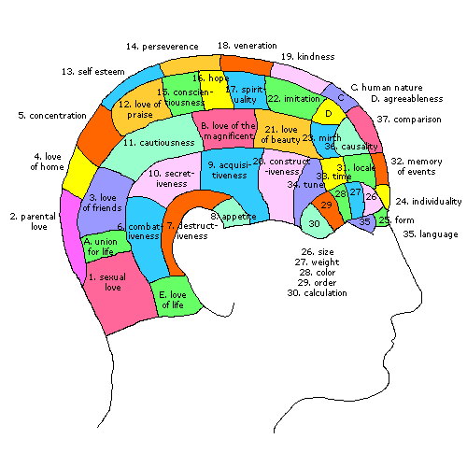

Slide 14
Localization – definition review
Tracing the origin of a behaviour, emotions, cognitive processes, to an exact location in the brain

Slide 15
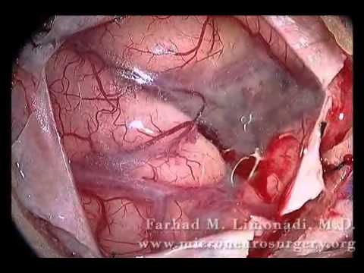
Challenges w/early study of Local…
Scanning technology not developed
Not ethical/ appropriate to purposefully harm brains (or animals) Experimentation
IV: harm to an area (no reverse)
DV: behavioural change

Slide 16
Early investigations based on…
Looking/observing
Listening/talking
Identifying patterns
Unique circumstances/ accidents taking place ----------→
Qualitative methods, right?

Slide 17
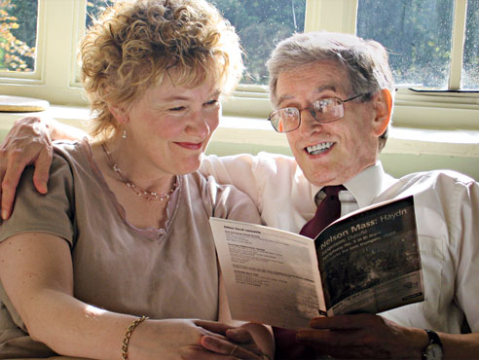
Qualitative method: Case study
In depth, detailed examination of a person, group, organization or event.
Phineas Gage, ‘Tan’, ‘Genie’, ‘HM’ are all unique cases (intrinsically interesting…)
But, they could never be completely replicated

Slide 18
Method : Review ‘Case study’?
Examination of human/event experience
Research strategy to compile info about an occurrence, especially when something unique happens….
Triangulating method:
Observe – overtly or covertly
Medical files/history
Interview family/friends/ bystanders
MRI/fMRI/CT/PET results

Slide 19
Localization warm up tasks: 10 mins
Define localization together
Chat about general methodological challenges with investigating localization.
How would you approach an Intro? Write an intro SOLO:
LAQ: Evaluate localization as an explanation for human behaviour.

Slide 20
Intro practice:
LAQ: Evaluate localization as an explanation for human behaviour.

Slide 21
Intro practice:
Localization generally argues that behaviors, emotions and cognitions may be traceable to a precise brain areas. It is necessary to understand localization for appropriate brain mapping, particularly in brain surgery. Broca’s early work with ‘Tan’ showed elements of strict localization in that speech production could be precisely linked to the left front cortex in what is still known at ‘Broca’s Area’. However, in modern day, localization theory is simply not broad enough to explain how the brain compensates and adjusts to form new connections.

Slide 22
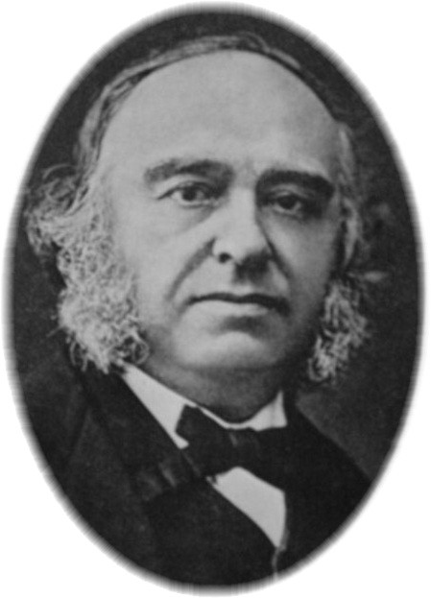
Early L of Fun. Case: Paul Broca/’Tan’
1824 - 1880

Slide 23
Broca’s study:
Worked w/ stroke patients/ noticed speech impediments
Tried to find connections b/w speech problems → brain injuries/damage
Tried to determine if specialization occurred in the brain, meaning areas of the brain responsible for certain tasks
Ie: occipital lobe → vision

Slide 24
Broca’s study of “Tan” (case)
Tan could only say ‘Tan’
Tan lost ability to speak → lesion in his temporal lobe
The study of Tan’s brain → autopsy
Lesion caused by syphilis (infection)
From this, Broca connected the lesion impaired functioning → loss of speech

Slide 25
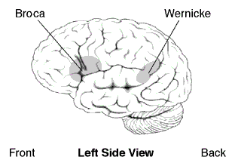
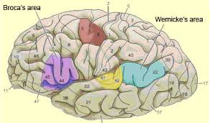
Broca’s Area
G2C site; check out frontal lobe/Broca’s Area

Slide 26
Aphasia
Broca’s Aphasia
Wernicke’s Aphasia
Loss or impairment of language production
Language comprehension is decent
Speaking laboured/usually 4 words at a time
Vocab range diminished
“Non-fluent aphasia”
Production is decent/fluent
Comprehension is impaired
Understanding of words damaged
Speaking quite smooth
“Fluent aphasia”

Slide 27
Aphasia clips
Broca’s Aphasia
Wernicke’s Apashia

Slide 28
Broca’s Findings
Language production localized -- left frontal cortex (see pic)
‘Broca’s area’
Responsible for speech production, language processing, and language comprehension
Also controls facial neurons
Ideas of ‘strict localization’ – precise brain area (Broca’s Area) linked to precise behavior (speech production)

Slide 29
Critique (a practice we always wish to be in…):
Autopsy-based - no interactive testing could be done – dead brains are only so useful
No cause& effect from case study
Hard to specifically study brain while the patient awake w/o inflicting pain
Today, MRIs show functional activity of area

Slide 30
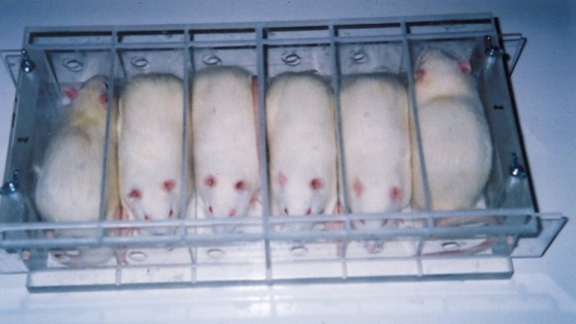
Strict localization – pleasure!
James Olds
Rats
Electrical stimulation of nucleus acumbens (lever press)
Rats would walk across electrified grids (punishment) to reach pleasure inducing lever
Would select the pleasure lever ahead of food/water

Slide 31
Background Study: Lashley, distribution of function (OUP p51-52)
Sample: rats
Method: induced brain damage/IV irreversible
Aim: to test if memory was localized strictly in the brain
Procedure: train rats to learn maze; cortex removal
Why did he abandon hypothesis? He couldn’t find ‘one area’; amount of cortex removal mattered – not location
Key finding/Challenge to strict localization? Knowledge of memory as distributed, not localized.
What is ‘relative localization’? Some local’n for some functions (speed production) but acknowledged limits to theory
How does the case of HM show relative localization?

Slide 32
Key Study: HM (case study; autopsy) William Scoville (surgeon); Brenda Milner, Suzanne Corkin
(Handout/article – please read)
Debilitating epilepsy; disruption - quality of life
Surgery, 1953; partial removal of both hippocampal areas (5cms of tissue); some temporal lobe tissue
Finding: Post surgery retrograde/anterograde amnesia (30 sec memory); lived in working memory; hippocampal areas critical for memory conversion (localized function)
Could not convert episodic, semantic memories; STM → LTM; could form procedural mem’s (MSM model support)
Ongoing research w/HM (interviews, brain scans/MRI, memory activities)
Death of HM 2008; final brain scan & brain dissection (over 2400 slices preserved)

Slide 34
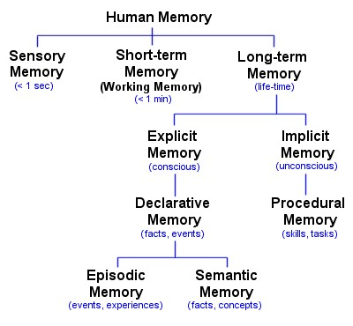

Slide 35
Case of HM
Value
Limitations
Unique brain case – learning opportunity for psychologists (heuristic)
Longitudinal: data gathered over long period of time; comparative
Vast quali/quanti data; brain preserved over time
Testing yielded support for distinct memory stores (MSM)
Unique case – replication impossible (but not expected)
Lack of generalizability
Cause & effect not inferred about precise role of hipp or surrounding brain areas

Slide 36
Key Study: Maguire et al (2000)
Read (p61 OUP text) Quick clip
Aim, procedure, findings
Sample characteristics
Why MRI?
Who was excluded? Why?
Define anterior/posterior
Summarize the ‘shift’ that happened in the hippocampus
Explain bi-directional ambiguity (p61 top)

Slide 37
Key Study: Maguire et al (2000)
Aim: investigate if hipp size differs based on spatial/nav exp
Procedure: ethical procedures/overviews; establish exclusion criteria; assess sample control/taxi drivers; conduct/analyze MRI scans
Sample characteristics: male, 32-62 yrs; in good health; taxi experience; licensed; range of driving taxi 1.5-42yrs!
Brain scanning technique (MRI)? Focus on hipp structure; size differential
Exclusion criteria? Below 32/over 62 yrs; females; left handed; health issues- control confounding variables
Which variable is not fully controlled for? Impact?

Slide 38
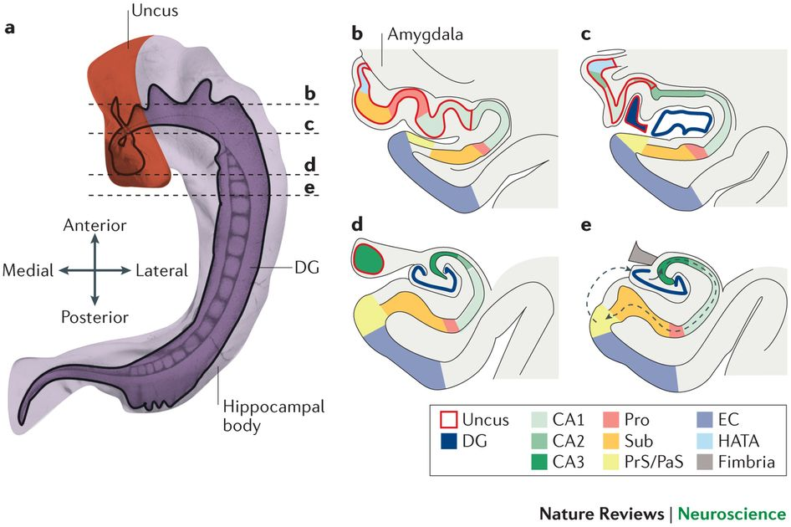
Key Study: Maguire et al (2000)
Bi-directional ambiguity: does experience impact hipp distribution or does hipp dist predetermine career choice?
Is biological determinism at work? Further testing correlated time as driver w/distribution → validity
Findings: posterior (rear) hipp neural mass higher in taxi driver sample; anterior (frontal) hipp neural mass higher in control group

Slide 39
Key Study: Maguire et al (2000)
Interpretation Localization: precise role of hipp activity implicates role of hipp in navigational, procedural LTM
Interpretation Neuroplasticity: movement/distribution of matter within hipp shows neural reorganization/reconnection

Slide 40
At home:
Read
Neuroplasticity: 56-63
Notes & CT Merzenich & Draganski et al (2006); exam study

Slide 41
References
http://z.about.com/f/wiki/e/en/0/03/BrocasAreaSmall.png
http://www.sci.uidaho.edu/med532/Broca.htm
http://www.wisegeek.com/what-is-brocas-area.htm
http://www.youtube.com/watch?v=Fw6d54gjuvA&feature=related
http://www.youtube.com/watch?v=12dO78c6-q8
http://www.aphasia.org/Aphasia%20Facts/aphasia_facts.html
http://www.whonamedit.com/doctor.cfm/1982.html
http://en.wikipedia.org/wiki/Paul_Broca
http://findarticles.com/p/articles/mi_g2699/is_0004/ai_2699000404/?tag=content;col1

