Slide 1
Inductive Content Analysis
Paper 3
Qualitative Methodology

Slide 2
Interview revision:
Evaluate strengths:
Semi structured interview (elaborate, less biased, flexibility, allows for analysis, doesn’t go too far off track – little spontaneous questioning)
Focus groups (ease of data coll, fairly natural, relaxed setting, explorative – what how why)
Narrative interviews (explore the complex individual, usable with all people; take advantage of the storytelling side of humans)

Slide 3
Interview revision:
Evaluate limitations:
Semi-structured: fairly rigid approach – opportunity can be lost; they yield much data – analysis $$
Focus groups: dominant speakers can take over; tangents; conformity in groups
Narrative: tangents; huge amounts of data collected and not all relevant; time consuming/$$ to analyse; one part at a time

Slide 4
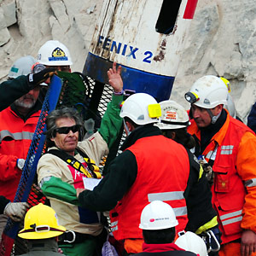
IPA
Interpretative phenomenological analysis
Close examination of person/phenomenon of interest
The person/group offers specific interest to the researcher

Slide 5
You should be able to:
Understand the basic stages researchers go through as they use inductive content analysis on transcripts (the record of the interview or obs)

Slide 6
‘Inductive content analysis’ fancy speak for:
Analyzing interview transcripts, acknowledging and organizing main ideas that emerge from what has been said.
Inductive → Theory can emerge from data (what is said)
Organizational tool
Idiographic (focus on the individual)
Remember - you don’t have to conduct ICA in P3
You might refer to how researchers use it as part of another pre-determined Q – info provided for you

Slide 7
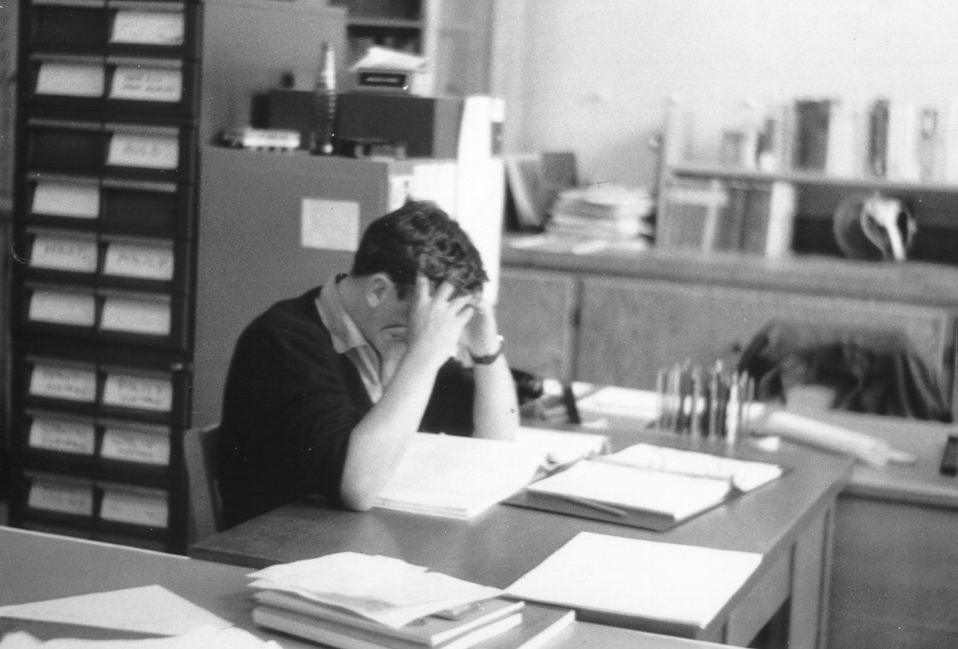
Stage 1: Reading/re-reading
Read transcript
Read it again!
Note-take in margins
First reactions
Phrases that stick out
Language use
Summary statements
Aim: data saturation

Slide 8
Stage 2: Emergent themes
Notes that characterize each section of responses
Ex: (How Sutherland copes with the media)
Also called ‘raw data themes’ (not processed – they have not been organized into categories)

Slide 9
Stage 3: Structuring ETs
List ETs, look for relationship
Labels given that capture themes
‘Media pressure’ (desc)
‘You can’t listen to them’
Organize emergent themes
into higher order themes

Slide 10
Stage 4: Summary table of STs and Quotes
Presentation of themes that capture essentials of the interview
If media/player pressure mentioned 6 times, family 4 times and vacation 1 time in 1000 word interview, perhaps vacation not represented as a ST

Slide 11
Move through stages:
Code your data see what emerges
Try to identify themes (3-4)
Find evidence (quotes) in your data to support your themes
Create a simple table that shows themes w/evidence
Write a brief synthesis of what you learned from your interview

Slide 12
Considerations that must be taken into account:
Interviewer training
Gender/age/ethnicity of interviewer
Guide/script for interview
How will data be recorded?
Transcription: how will interview be put into text?
Verbatim = word for word
Postmodern = pauses, laughter, interruption etc is included
Inform about research
Informed consent
Debrief/confidentiality/anonymity
Right to withdraw

Slide 13
Higher Order Themes Script for Kelly Sutherland (SSI)
Fitness
Mental prep and focus/coping
Fighting/hits
Consensus with officials
Media/public opinion
Life/work balance
These focal points
Reflect what the interviewer wants to know about
Provide structure to the interview

